Slide 1

SEND Information Report 2025/26
Rebecca FOX
SENDCo
rfox@burrowmoor.cambs.sch.uk
This SEND Information Report has been written alongside the SEND Policy and Accessibility Plan and to comply with the revised SEND Code of Practice 2014, Children and Families Act 2014 and the Equality Act 2010.
Notes:
Add photo and school logo
Who are you , and a bit about you – have you done the NASENCO
Contact needs
Disclaimer

Slide 2


How do we make the school inclusive and a positive environment for children with SEND?
Unconditional positive regard
Engaging learning
Caring and therapeutic attitudes
Part of the school community
Notes:
Unconditional positive regard – starting each day fresh
Teachers altering planning to fit specific needs of children to help with engagement
Kind and clear support
Part of the community/classroom

Slide 3

How do we identify that a child has special education needs or disabilities?
Look at regular assessments and data
Teacher and parent observations
Talking to previous schools if they are new to the school
Information from other services involved such as health
Notes:
Monitor progress and achievement in regular assessments - may do additional assessments from this too
Observations/what has been seen in school and at home
Conversations with previous schools/preschools/primary/first…schools
Conversations with other professionals – health, social care, …
If parents have concerns please talk to school.

Slide 4
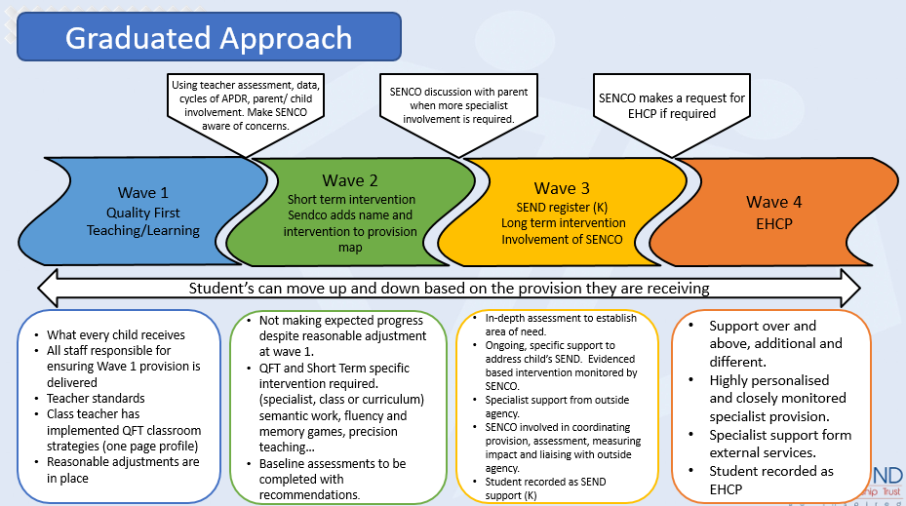
How do we support children with SEND?
All children (with SEND or not) are supported by:
Quality First Teaching
Inclusive environment
Reasonable adjustments
Teaching adaptations
Teacher or TA support
Monitoring of progress
Notes:
How much children are supported can be described using the graduated approach – children can more up and down the stages based on their needs.
All children get wave 1 support – QFT, this also includes QFT, inclusive environment, reasonable adjustments and teaching adaptations teacher or TA support and monitoring of progress. Progress is monitored and if progress is not made, move to
Wave 2 and 3: short term additional targeted support or interventions (provision additional to or different from that for most children)
Wave 4: EHCP level support (will talk about more later)

Slide 5
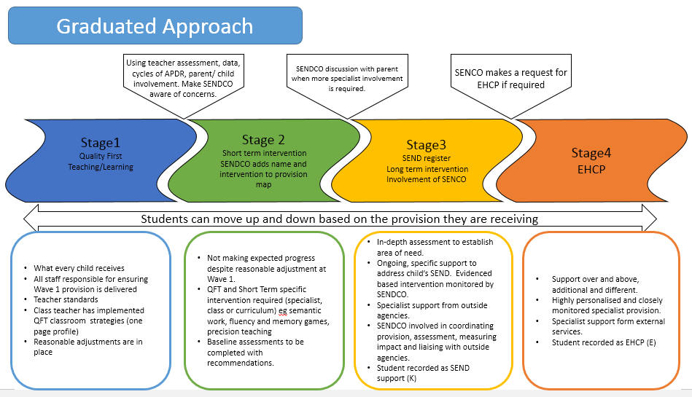
How do we support children with SEND?
Notes:
How much children are supported can be described using the graduated approach – children can more up and down the stages based on their needs.
All children get wave 1 support – QFT, this also includes QFT, inclusive environment, reasonable adjustments and teaching adaptations teacher or TA support and monitoring of progress. Progress is monitored and if progress is not made, move to
Wave 2 and 3: short term additional targeted support or interventions (provision additional to or different from that for most children)
Wave 4: EHCP level support (will talk about more later)

Slide 6
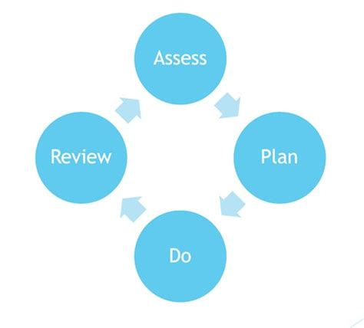


How do we support children with SEND?
Every child is different, so will need different adjustments or curriculum adaptations
Targeted support may be provided 1:1 or in a group and may involve liaison within school or with external professionals
Assess Plan Do Review Cycles
Monitoring of progress - SEN support/EHCP
Notes:
Reasonable adjustments may include – ear defenders, writing slope, wobble cushion, overlays, lap pads, visual support, AAC (alternative and augmented communication),
Adaptations may include use of Clicker, ICT to support, talking tins, scribes,
Targeted support may include: SALT, Sensory circuits, physical need exercises, fine and gross motor skill excercies, phonics support, reading, maths, SEMH needs, social skills, attention bucket, identiplay, direct phonics, numicon, FFT, little wandle, toe by toe, plus 1, power of 2, 5 minute box
Provision is monitored through APDRs (assess plan do review cycles). continuing difficulties and lack of progress may consider moving to Wave 4: EHCP level support.

Slide 7
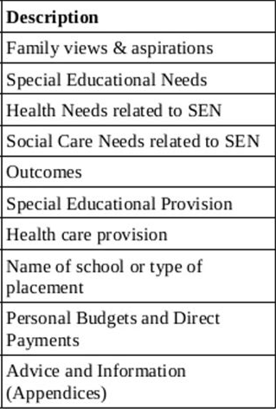
What is an EHCP?
EHCP: Education Health and Care Plan.
The majority of children and young people with SEN and disabilities will have their needs met through SEND support. Those with complex needs that cannot be met by the ordinarily available provision support put in place by their school or college, an Education, Health and Care needs assessment may be required. This may lead to an EHCP.
Notes:
An EHCP is a legal document that identifies a child’s SEND that are multiple, complex and has a significant long term impact on their education. The document outlines the needs, targets and help that is needed to support the child.
When further support beyond reasonable adjustments and classroom intervention is required, schools consider the evidence required to meet the threshold carefully before deciding to apply for an EHCP. This includes multi-agency involvement as well as APDR assess plan do review cycles.
Link on local offer/SEND information hub

Slide 8

How do we monitor progress?
Classroom assessments and observations
Targeted Support baselines/end assessments
Assess Plan Do Review Cycles
Parent input
Pupil voice
Notes:
Progress for all children is also measured termly though assessments and informal observations
Baselines are taken before targeted support such as (list school interventions – egdirect phonics, numicon, FFT, little wandle, toe by toe, plus 1, power of 2, 5 minute box) and impact is measured after completion
Targets set through APDRs are reviewed termly and discussed with parents at termly parents evenings
This also includes pupil voice

Slide 9



How do you work with families to support children with SEND?
Communication with parents
Assess Plan Do Review Cycles
Annual reviews
Gathering pupil voice
Notes:
Communicate with parents – at the classroom door, phonecalls, emails, on the playground – please contact us – work together
APDR – termly
Annual reviews for children with EHCPs
Gathering pupil voice – important to have the views of children and young people – these can be gained through questions, playing games together, observations, PECs,

Slide 10

How do you work with families to support children with SEND?
School Website
Education Inclusion Family Advisor
Early Help Assessments
SENDIASS and Pinpoint
Learn together website and OAP toolkit
Cambridgeshire SEND information Hub (Local Offer)
Cambridgeshire Children and Young People’s Health Care
Notes:
School website includes some information/support resources/links
EIFA does:
- Working with allocated schools within your area.
- One to one support to families virtually or face to face on a range of topics including but not limited to: Challenging behaviour, Sibling Rivalry, Sleep, Routines etc.
- Working with colleagues to offer interventions such as workshops, and drop ins. Producing monthly newsletters and other posters relating to the service.
- Working closely with a range of professionals such as Schools, Targeted Support, Voluntary sector support services and Health.
- Signposting to a range of voluntary and statutory services.
EHA
The Early Help Assessment is used for all Early Help requests where a multi-agency approach is required. It leads to:
District Early Help services (family workers). The Early Help Hub will suggest an initial Family Support Plan and they or the District Team will review the closing plan – May signpost to a better-placed service or intervention outside of the Council through the Cambridgeshire Online Directory. For preschool children the EHA will put the children onto the early support pathway.
SENDIASS can help you with
Confidential support and someone to talk to in confidence
Advice and information about special educational needs
Independent Support for children, young people and families as Statements are transferred to EHC Plans
Preparing for meetings with your child’s school or with professionals who are working with your child
Information on your rights and responsibilities as a parent, children’s rights and SEN law and guidance
Information about local support groups and voluntary organisations
Pinpoint - Pinpoint Cambridgeshire is run for parents – by parents.
We give help and information to parent carers of children and young people aged 0-25 with additional needs and disabilities, and give parent carers opportunities to have a say and get involved in improving local services.
No formal diagnosis is required to access support from Pinpoint – a child may be on a waiting list, accessing services, had a referral turned down, or just be struggling.
Learn together – is the home for the OAP toolkit and the SEND transformation in Cambridgeshire. It also has information on the early years and childcare as well as listing services to school and school improvement information
OAP toolkit (Ordinarily Available Provision)
This Cambridgeshire resource is for schools and other education settings. The purpose of this is to define for Early Years settings, Schools, and Further Education providers in Cambridgeshire what provision should be (ordinarily) available for children and young people with SEND. We hope this will also support parent, carers and professionals to work with schools to support children with SEND.
Local offer/SEND Information Hub – further information about targeted support, education and social care. There is also a young persons zone which can help with making friends, getting advice and learning new skills.
Cambs community health website - information on emotional health, community paediatrics, specialist nursing services, family nurse partnership, PT, OT, SALT, LAC, dietician.

Slide 11



How does the school work with outside agencies?
Health
SEND district team
Family workers and Educational Inclusion Family Advisor
Social care
SENDIASS and Pinpoint
Notes:
Health Services include SALT, Paediatrician, OT, PT, health visitor, YOUnited/ CAMHS/ CHUMs/ MHST – Referrals are made through school and require evidence of need and initial support in school before a referral. Referrals may be quite time consuming to do and, once referred, waiting lists for some services can be long.
SENDSS – specialist teachers, specialist practitioners, EPs, multi sensory team (for VI/HI), Access and Inclusion – involved through school request
Family workers and Educational Inclusion Family Advisor (EIFA), - EIFA via drop in, EHA for family worker
Social Care – liaison where appropriate
SENDIASS and Pinpoint – parent support groups, liaise where appropriate.

Slide 12
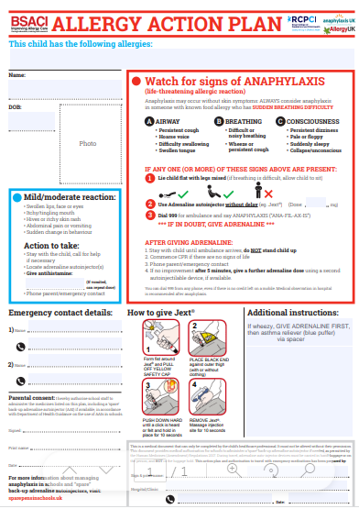
How do we support children with medical needs and disabilities?
Discuss the needs of the child on an individual basis
Take advice from other professionals where needed
Agree a plan that meets their needs
Notes:
Discussed according to individual needs – which includes among other things; diabetes, anaphylaxis, asthma, epilepsy, medicated ADHD, and toileting difficulties, as well as physical needs and mental health needs. There will often be close liaison with healthcare professionals.
A plan to meet needs may be an Individual Healthcare Plan – sometimes referred to as Individual Health Care Plan (or Individual Health Education Plan in Cambs) which may include an agreement to administer medication.
Plan may also include an Intimate Care Plan if care required is of an intimate nature – eg toileting support.

Slide 13

How do we support children’s emotional wellbeing?
Pastoral Support – We have two trained ELSA (Emotional Literacy Support Assistants). Pupils also have access to Drawing and Talking Therapy, Play Therapy and Lego Therapy.
We have Mental Health Support Team (MHST) trained ‘Wellbeing Warriors’ involving Y5/6 pupils who are able to support fellow peers with their worries and to signpost them to help.
Targeted Social Support – Lego Therapy and Comic Strip Conversations.
PSHE/RSE curriculum
Outside agency involvement when required.
Notes:
PSHE Personal Social Health and Economic Education includes regular consideration/discussion of emotional wellbeing
Pastoral support from all staff, daily/weekly check ins, meet and greet, therapy dogs, mentoring, drawing and talking therapy, play therapies (1:1 or group), STEPS (Cambridgeshire Therapeutic Thinking),
Social support – guided games playtime support, Lego Therapy
More complex needs may require outside agency involvement – MHST, YOUnited, CAMHS, support from SENDSS with emotional based school avoidance

Slide 14

How do we support children to access the wider curriculum?
Reasonable adjustments to access trips and activities
Some SEND or other additional need specific events
Risk assessments
Discussion with parents
Visuals and social stories
Pre-visits where appropriate
A designated sensory rich provision to support the regulation of specific SEND pupils.
Notes:
Extra curricular activities include – trips, visitors, after school clubs
Sometimes additional SEND events eg local area SEND PE events, Young Carers club
Risk Assessments done to make events accessible (physical access/environmental and sensory management/safety) – eg toilet access/quiet space access for Young Voices, additional adult support, rest breaks in the day…
Liaise with parents and then support to prepare for visits ahead of time.

Slide 15

What training have staff had for supporting children with SEND?
Training for specific individual needs
Observing, shadowing and modelling
In 2023/24 staff received training in social communication, supporting neurodivergence, trauma informed/attachment and Emotional Based School Avoidance so that they are understand the complexity of a child’s lived experience and its impact.
Training from a range of external services, including SEND Specialist Services and MHST.
Notes:
Different every year depending on needs of children and staff
Training courses though school and DLPT staff meetings/ training days and online courses as well as externally provided courses may include: provision for children with SEN, dyslexia awareness, supporting early reading, meeting needs of children with Autism, writing APDRs, it also includes first aid.
Training for specific individual needs is in place as required including statutory training to meet medical needs (eg us of gastro tube; diabetes) and direct training for staff working with individual children with SALT needs, Autism or other communication needs, physiotherapy needs, complex SEMH behaviours…
Staff also observe and shadow experienced staff to see models of supporting children with SEND both within and beyond school eg specialist practitioners – to widen experience and develop confidence.

Slide 16

What will happen when my child moves class or school?
Transition information shared with relevant staff in school
Transition information shared between previous or next school
Observations of child or meeting with previous or next school
Social stories
Stay and play sessions/ visits
Notes:
Transition information for all children with SEND – what works well, what is not effective, support in place, outside agency involvement etc – shared – verbally and/or written – in school
Transition information for all children with SEND – what works well, what is not effective, support in place, outside agency involvement etc – shared – verbally and/or written – with previous/new school – Nursery to infant, to school, to AP, to special, to Secondary, to middle/from first… infant/junior
For more complex needs may observe children/meet with previous or next setting - depending on level of need parents may also be involved.
Social stories, stay and play sessions, additional visits etc will be used to support children with the transition.

Slide 17

What if I am not happy with the provision for my child?
First talk to the class teacher
Next talk to the SENDCO/Deputy Headteacher,
Mr Harfield
Then contact the Headteacher, Mrs Bailey.
If you are still not happy, then follow the complaints procedure accessible on the school website.
Notes:
In order – first class teacher – they work most directly with your child
Next SENDCO – they have the more specialist SEND knowledge – email, phone or directly in person
Then head/assistant/deputy head – most senior in school
Complaints procedure is on the website.
At all points we would always expect to work with you to unpick and address your concerns so that together we can best meet the needs of your child.

Slide 18
Testimonials
“Hi Mr Harfield. Thank you to both you and Miss Sewell for taking the time to meet with me today. We are very grateful for your support and help. It’s taken us a long time to decide to ask and you both made it very comfortable and easy!”
Year 4 parent – October 2023
“I really appreciate all your hard work to get my child the support that she needs. It doesn’t go unnoticed and I am so grateful”. Parent of pupil with an EHCP – July 2024
Notes:
In order – first class teacher – they work most directly with your child
Next SENDCO – they have the more specialist SEND knowledge – email, phone or directly in person
Then head/assistant/deputy head – most senior in school
Complaints procedure is on the website.
At all points we would always expect to work with you to unpick and address your concerns so that together we can best meet the needs of your child.

Slide 19
Testimonials
“With your support and understanding, I feel as if my child has progressed loads. I can’t remember the last time I felt this supported”.
“For the first time, x is enjoying school. Not only has this drastically changed drop offs at school, he is happier at home too”.
Year 5 parent - August 2024.
Notes:
In order – first class teacher – they work most directly with your child
Next SENDCO – they have the more specialist SEND knowledge – email, phone or directly in person
Then head/assistant/deputy head – most senior in school
Complaints procedure is on the website.
At all points we would always expect to work with you to unpick and address your concerns so that together we can best meet the needs of your child.

Slide 20
Testimonials
“We are thankful for the support given and proactive approach to help aid my child’s transition to Burrowmoor Primary Academy. We look forward to watching him grow in confidence as he settles in to school”.
Year 3 parent – September 2024.
Notes:
In order – first class teacher – they work most directly with your child
Next SENDCO – they have the more specialist SEND knowledge – email, phone or directly in person
Then head/assistant/deputy head – most senior in school
Complaints procedure is on the website.
At all points we would always expect to work with you to unpick and address your concerns so that together we can best meet the needs of your child.

